Slide 1
L1088 Environmental Economics
Richard S.J. Tol

Slide 2
A very short introduction
A free market will not deliver environmental quality
Environmental economics is about
the desired environmental quality and
the best way of delivering that
It is a framework for thinking about trade-offs
Zero pollution is not desirable
We can price goods and services that are not traded on markets
Command and control rarely works
Market-based instruments protect the environment at lower cost
The burden of pollution often falls heaviest on the marginalized
We can extend the national accounts to the environment

Slide 3
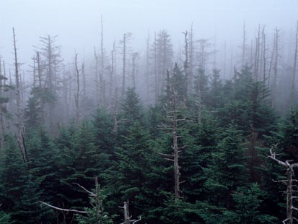
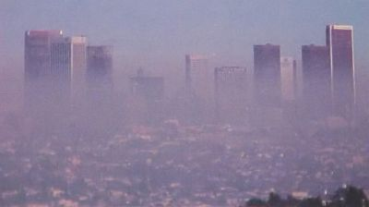
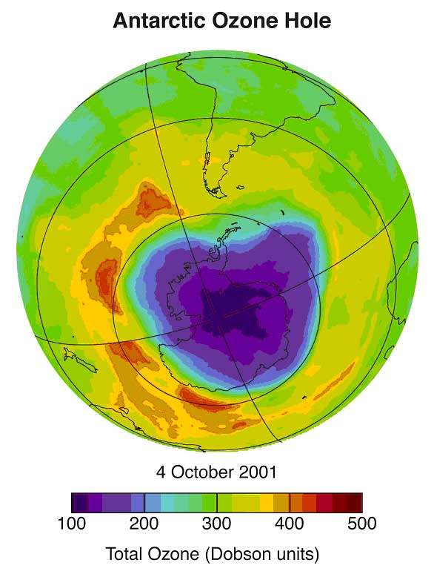
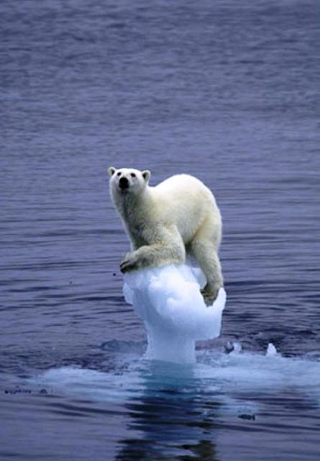
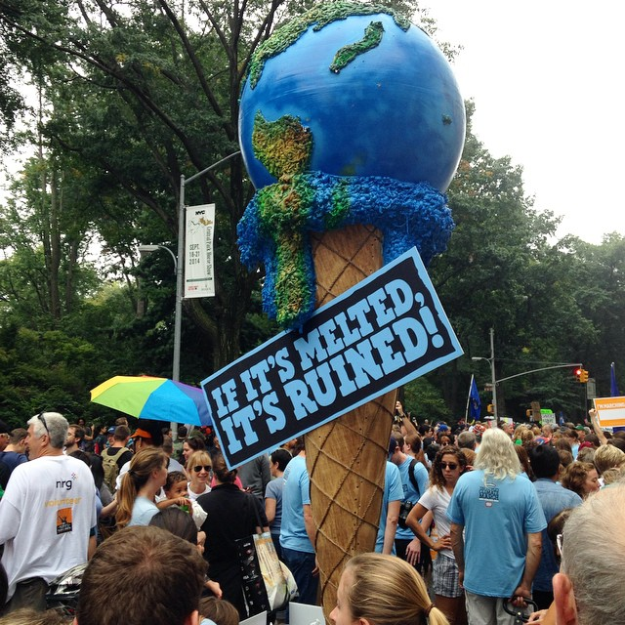

Slide 4
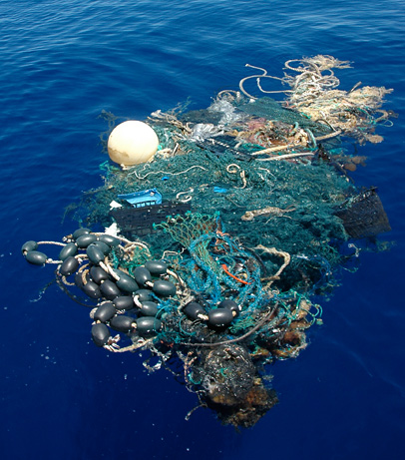
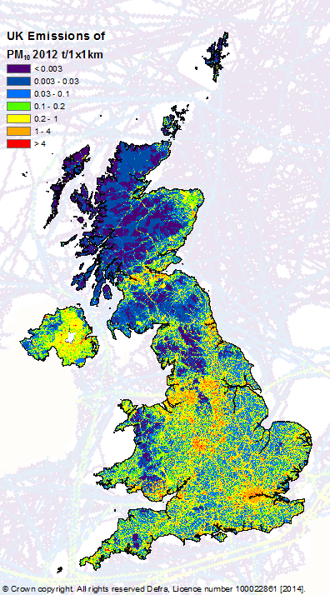
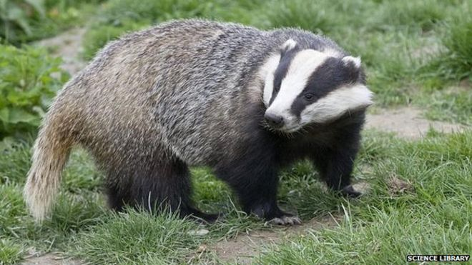
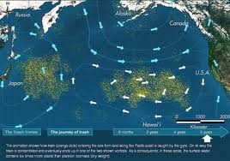

Slide 5
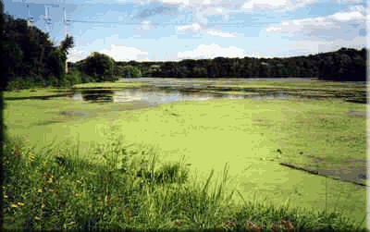
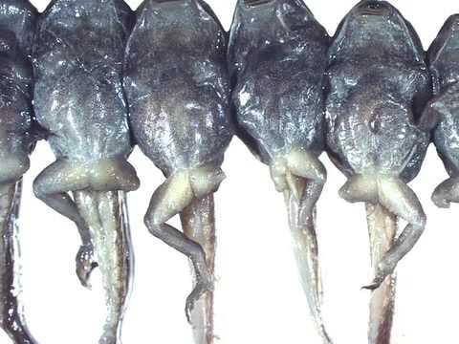
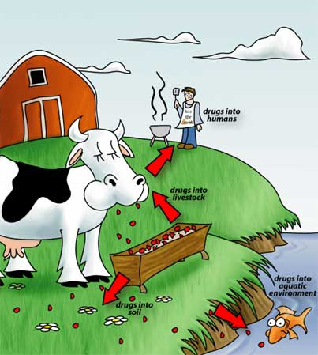
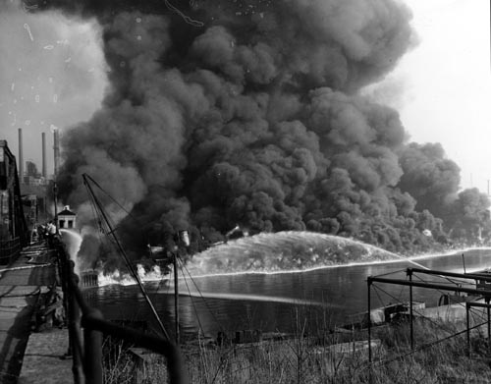

Slide 6
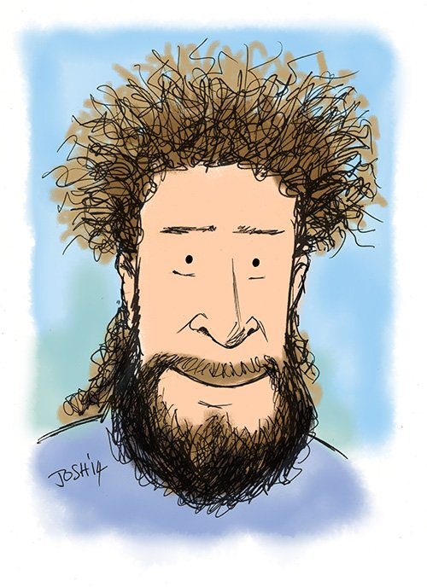
About me
Dr Richard S.J. Tol MAE
Professor of economics
Working from home / Jub 281
24-7 Office hours
Email: r.tol@sussex.ac.uk
Skype: richardsjtol
Key interests: climate, energy, environment

Slide 7
The Course
A comprehensive introduction to the economic theory of environmental pollution and environmental policy
Prior knowledge
micro, macro, calculus, econometrics
Book
C.D. Kolstad (2011), Intermediate Environmental Economics: International Edition (2nd Edition), Oxford University Press, ISBN 0199732655
R.S.J. Tol (2024), Lecture Notes (unpublished and unfinished), on Canvas
Lectures: Tue, 10 - 12 pm, Fulton B
Seminars: Monday

Slide 8
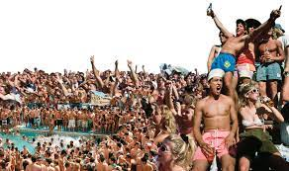
0 Introduction
1 Social choice
2 Externalities and public goods
3 Decision analysis
4 Valuation: Aims and purpose
5 Valuation: Revealed preferences
6 Valuation: Stated preferences
7 Direct regulation
8 Market-based instruments
9 Complications with instruments / essay due
Spring break (3 weeks)
10 Growth and the environment
11 Green accounting

Slide 9
Seminars
Problem sets / discussions
Games
Readings
Exam preparation

Slide 10
Monday Seminars
Group 3: 11 am, Silverstone SB317
Group 4: 12 noon, Pevensey 1 1B8
Group 2: 2 pm
Group 1: 3 pm, Jubilee G36
Group 2:
week 1, 7, 9 in Ashdown House G5
week 2, 4, 6, 8, 10 in Fulton 203
week 3 in Pevensey 1 1B3
week 5 in Bramber House 255
week 11 in Jubilee G31

Slide 11
Grades
70% take-home exam
30% 2,000 word essay
Quizzes on Canvas are graded but do not count, for revision only

